Slide 1


Deep Sea Coral + Sponge Observations
Nancy Campos, Sarah Miller, Jake Vogt

Slide 2
Motivation + Summary
Interested in learning more about deep sea corals and sponges and how they changed over time
Assumption was that we would find less observations over time as well as lower depth in meters

Slide 3
Cleaning + Understanding Our Data
Data was pulled from the National Centers for Environmental Information – Deep Sea Coral Research and Technology Program
Our dataset was extremely large and went back to the 1800s which made it difficult to manipulate.
We decided to narrow down our data by focusing on years 2016, 2017, 2018 and three types of coral.

Slide 4
Data Visualization
PgAdmin was used as our database to store our data and SQL queries were used to narrow down our dataset to three types of coral and three years worth of data
Our focus was on the type of coral, the data source were the coral was found, the depth of the observation and the year it was observed
Javascript was used to create a leaflet map showing the locations of coral of over time
D3 , SVG, and plotly was used to visualize the depth of each coral observation

Slide 5
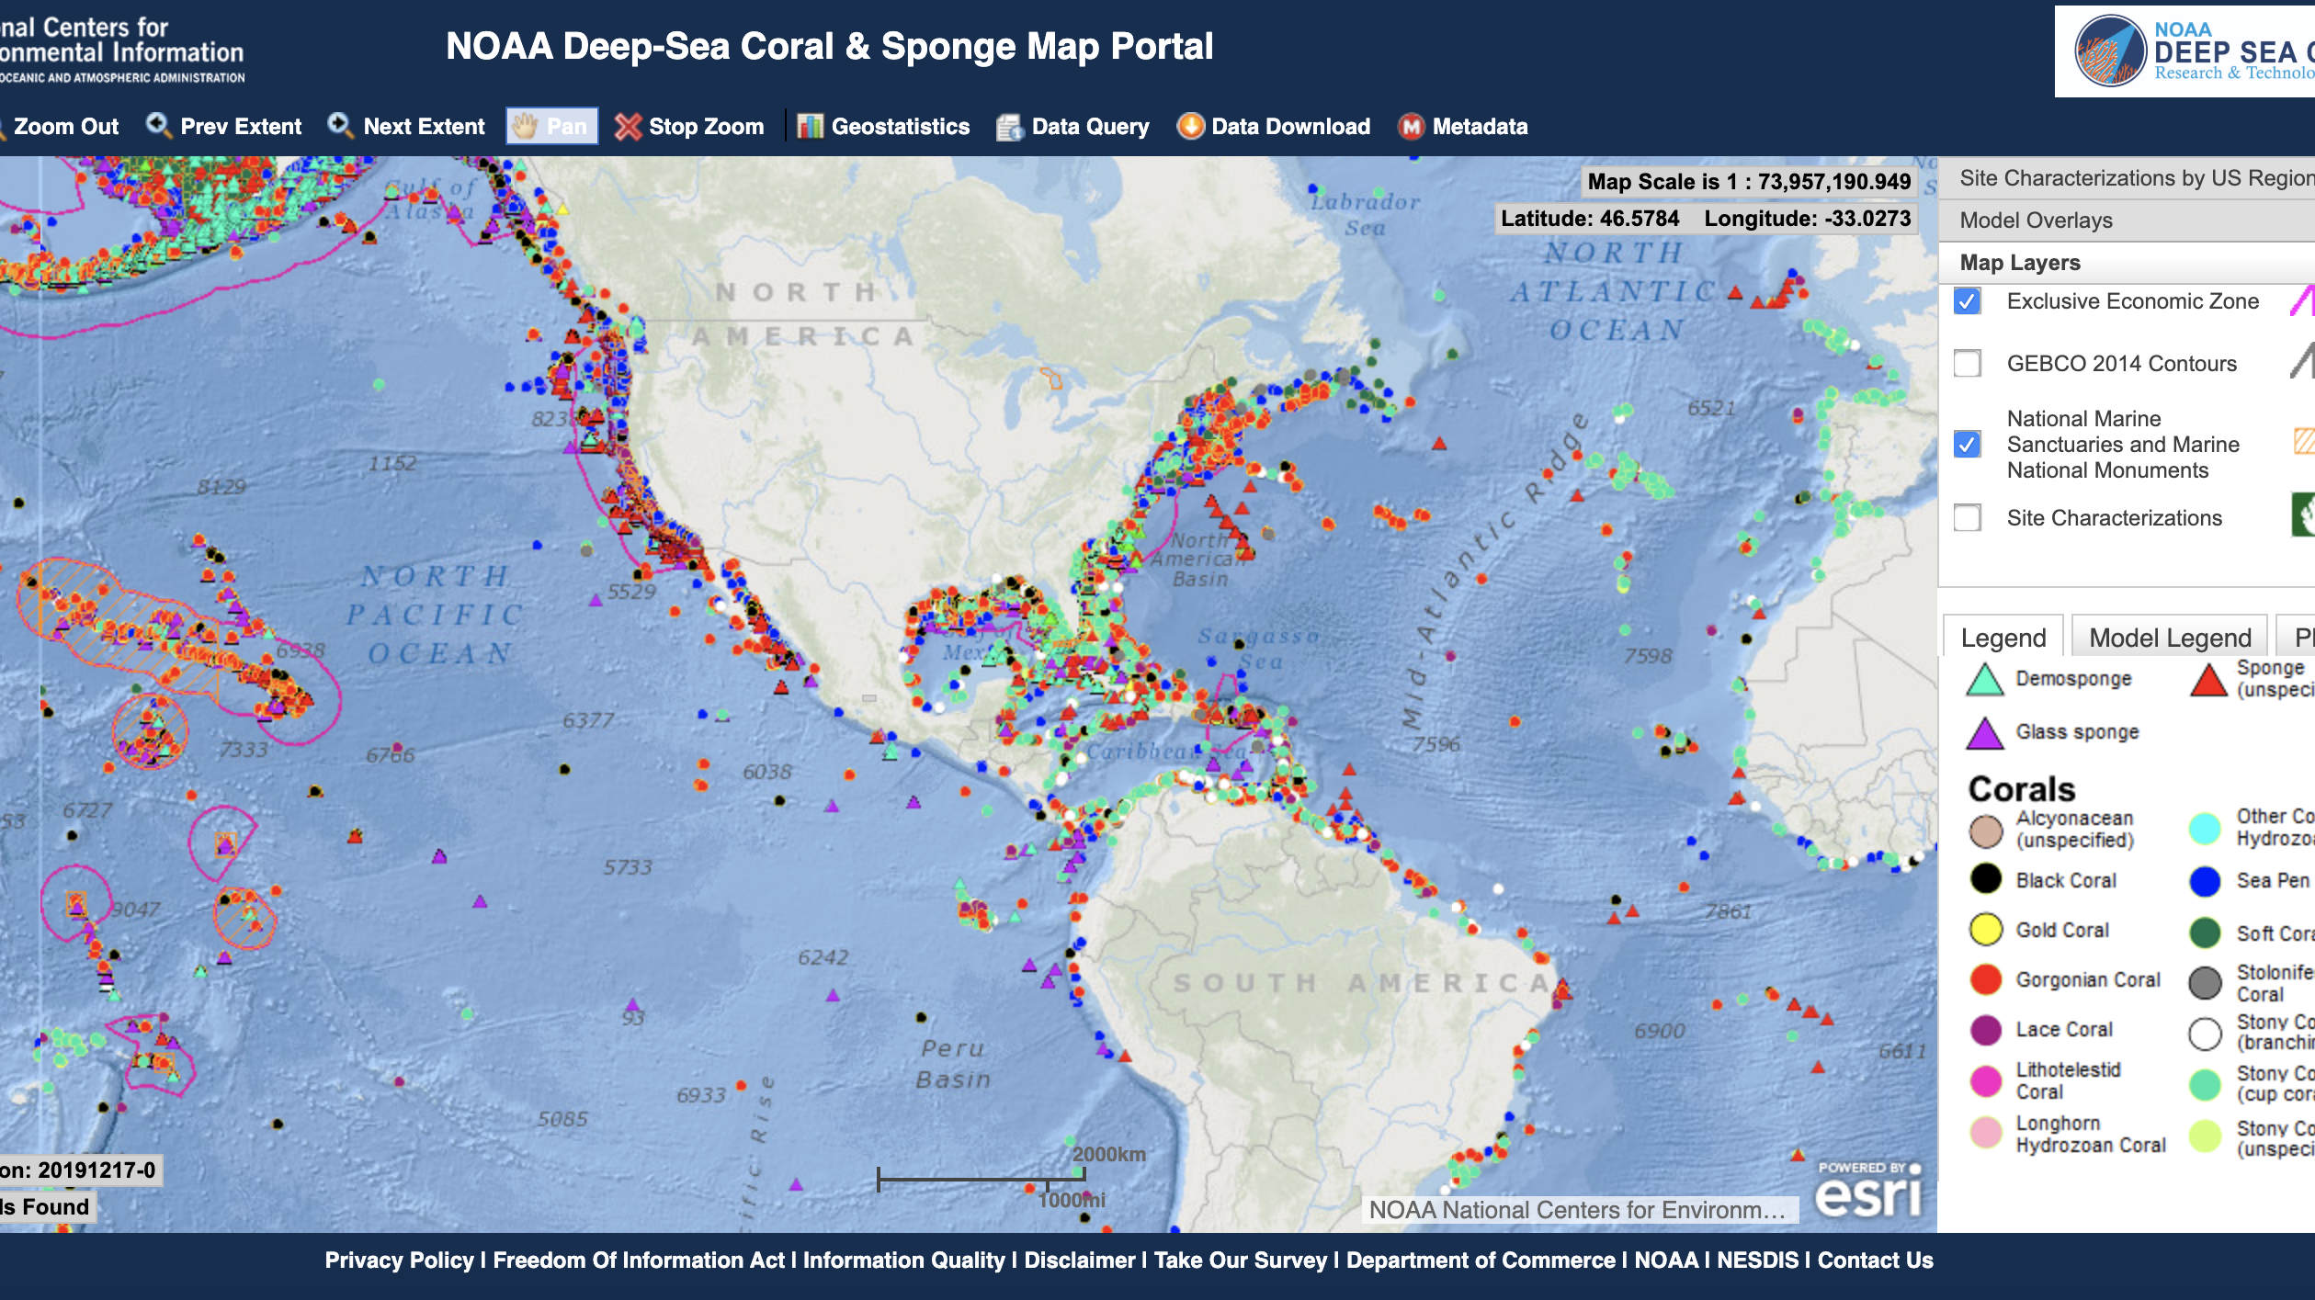
Inspiration for Our Visuals

